Slide 1



Effective Matching of the Demand for and Supply of Migrant Workers between Abu Dhabi Dialogue Countries of Origin and Destination
Presented by the ILO Regional Office for the Arab States
Notes:
On behalf of the ILO, I wish to congratulate ADD for selecting this topic which has a potential to impact the labor market of both GCC countries and Asian origin countries. This is also in line with their future visions to make GCC as one of the prosperous regions in the world.
- This topic is also important because the ADD has historically prioritized the of skills matching for more than a decade.

Slide 2
OUTLINE
01.
Context and Key Questions
02.
Research Methodology
03.
Snapshot of Labour Market Trends in Destination Countries
04.
Matching the GCC Labour Demand: Skill Initiatives
05.
Matching the Supply and Demand: Skills Recognition of Migrant Workers
06.
Emerging Best Practices in the Asia-GCC Migration Corridor
07.
Conclusion
08.
Policy Recommendations

Slide 3
CONTEXT
Over USD 120 billion
Remittance from 27 million foreign workers
(53% of total population)
Yet,
GCC countries suffer skill mismatches and shortages across industries, threatening the GCC labour market.
(World Bank, 2022)
Resilient economies
Despite multiple crises, Gulf Cooperation Council (GCC) countries remain resilient with a projected economic growth rate of 3.2% in 2024
(IMF, 2023)
Abu Dhabi Dialogue (ADD) member states have yet to develop a system to
create and share a regional skills database
match the skilled labour demand and migrant worker supply
establish effective mutual skills and qualification recognition frameworks

Slide 4
KEY QUESTIONS
01.
In what proportion does GCC countries' growing need for migrant workers reflect the labour market relevance of skills in the GCC and Asian countries of origin?
How do the lack of organized and accessible skills data and skills recognition affect the Asia-Gulf migration corridor?
02.

Slide 5
METHODOLOGY
DESK REVIEW
CONTENT ANALYSIS
FIELD OBSERVATIONS
Governments’ policies on skills recognition, ADD reports, academic and policy literature on labour migration
  Media reports on the Asia-GCC labour migration corridor and skills issues, bilateral skills agreements
  During interactions and consultations
SEMI-STRUCTURED INTERVIEWS
PROCESS TRACING
CASE STUDIES
Implementation processes of bilateral agreements
  Senior government officials, employers, migration policy experts, skills training providers, assessment and certification agencies, recruitment agencies, and migrant workers
  ADD GCC Destination: Saudi Arabia and UAE
  ADD Asian Origin: Pakistan, Philippines, and India
Notes:
Case studies to analyse skills demand and supply gaps and potential to improve matching
Saudi Arabia and UAE – 70% of these migrants are based in these two GCC countries. They also have the largest GCC economies in a post covid.

Slide 6
SNAPSHOT OF LABOR MARKET TRENDS IN GCC
Case Studies: Saudi Arabia and UAE
There is however a lack of responsive skill delivery mechanisms, programmes or partnerships for migrant workers or employers despite growing skills investment in Asia origin countries
- Rapid economic recovery after COVID-19 continues to create new jobs and has increased the demand of skilled foreign workers
- Despite growing labour market nationalization efforts, particularly of skilled and semi-skilled occupations, both Saudi Arabia and UAE have increasing labour market demands across various sectors:
Lack of Responsive Skilling
Skill demand data is mainly available with the private sector which is moving the demand
Freight, Logistics, and Transportation
Data Availability
Construction
Care work
(domestic work, health care professionals, and caregivers)
Service-Based Sectors
(Hospitality, etc.)
Notes:
Based on various secondary sources, the study presents rich data on occupations and skills demands in these sectors. For ex. According to industry forecasts, Saudi Arabia and the UAE will account for approximately 80 per cent of the total GCC healthcare expenditures in 2023. Currently, the UAE requires an additional 33,000 nurses by 2030, excluding other categories (nurse assistants, caregivers, etc.)
And these are prominent in these respective sectors—etc..

Slide 7
MATCHING THE GCC LABOUR DEMAND: SKILL PROFILES & INITIATIVES OF SELECTED ASIAN ORIGIN COUNTRIES & LABOUR SUPPLY DYNAMICS
ADD Asian-origin countries, including the Philippines, India, and Pakistan, have an adequate labour supply that can match the GCC labor demand in the short run.
Yet, the growing competition from other regional labour markets (i.e., Europe, East and Southeast Asia), specifically in the care sector, construction, and digital IT, can negatively impact the GCC states’ / private sectors' competitiveness in the long run due to opportunities, better conditions and protection in the former.
Philippines | India | Pakistan
Care sector (domestic work, caregiving, and nursing) | Construction | Construction
Construction (semi-skilled) | Digital IT sector | Transportation
Philippines-Japan Memorandum of Agreement on “Specified Skilled Workers” (i.e., nurses, healthcare workers, etc.) | EU-India Memorandum of Agreement on semi conductors | Pakistan and Saudi Arabia Bilateral Skills Agreement (under Takamol’s) Workers’ Recruitment Skills Verification Program
Notes:
Analysis of the supply side dynamics of labour supply suggests that …..

Slide 8
MATCHING THE SUPPLY AND DEMAND: SKILLS RECOGNITION OF MIGRANT WORKERS
Limited bilateral skills matching and recognition processes due to domestic sovereignty concerns between states.
Key examples:
Saudi Skills verification prog. is however moving across South Asia for construction sector
In general, trend in corporatized skills recognition and certification dominates the Asia-GCC corridor
There is a resistance from powerful private sector actors against centralized skills certification as this makes the workers more mobile and costly
UAE – India (Construction)
UAE-Philippines
(Construction, hospitality and other services sectors)
Saudi Arabia-India
(Mainly construction)
Implementation process of these bilateral skills matching initiatives is slow, inconsistent and has yet to bring the desired result.
Notes:
To address the process of ‘effective’ matching of the supply and demand systematically, as well as the skills recognition of migrant workers in the Asia-GCC labour migration corridor, multiple bilateral pilot initiatives have been launched. This paper specifically focusses on the UAE-India (2013-2018), UAE-Philippines (2014-2018), and Saudi Arabia – India initiatives (2023-present) to illustrate the ongoing progress and challenges faced by ADD member states in developing a harmonized framework for skills matching and recognition in the Asia-GCC corridor.

Slide 9
EMERGING BEST PRACTICES IN THE ASIA-GCC LABOUR MIGRATION CORRIDOR
  South Asia Qualifications Reference Framework
Innovations for Training
(UAE)
Lack of ADD host country-regulated skills recognition processes in the GCC has led multiple actors to establish diverse skills recognition and upskilling initiatives to increase competitiveness of migrant workers in the GCC.
Emerging skilling initiatives in the Asia-GCC labour migration corridor:
Philippines TESDA / Dept of Migrant Workers for upskilling in the GCC
Tadbeer (Upskilling for domestic workers)
  Private Recruitment Training and Certification Centers
Al Habtoor
(Upskilling construction workers)

Slide 10

The Philippine TESDA – Department of Migrant Workers’ Skills Recognition and Certification Collaboration in the Middle East
(in Dubai, UAE)

Slide 11
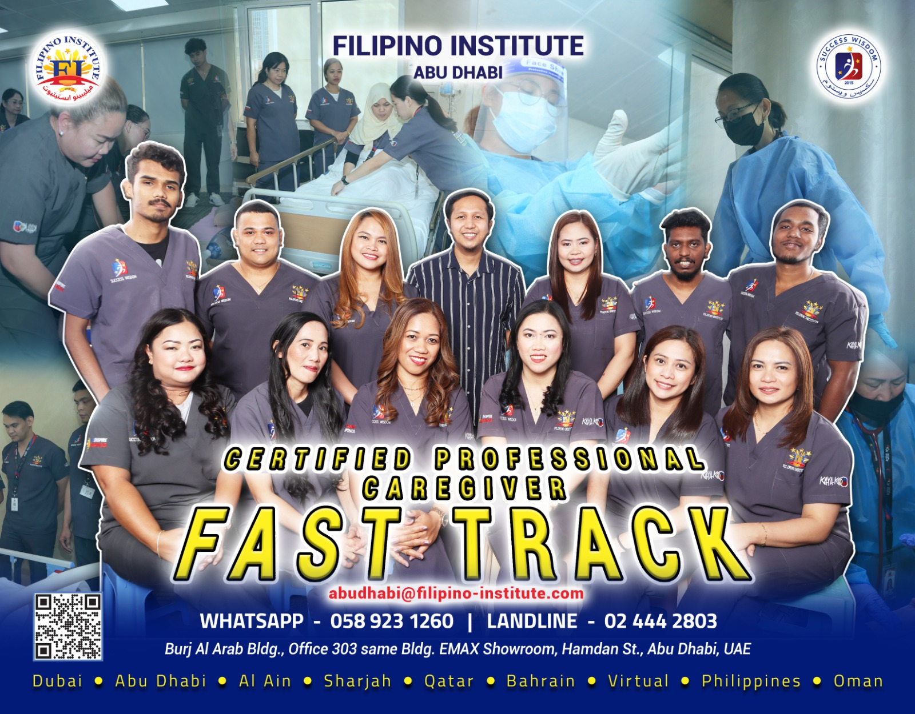
Private Recruitment Training and Certification Centers (for caregivers)

Slide 12

Housekeeping Co
(Dubai, UAE)
(for domestic helpers)

Slide 13
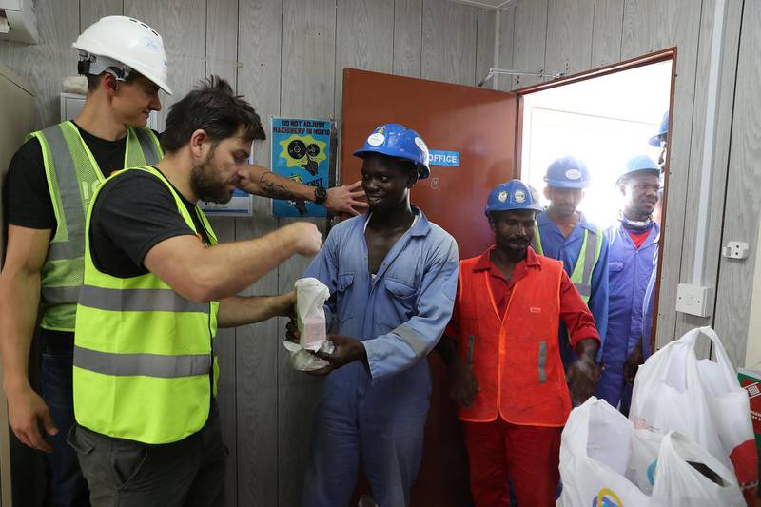
Al Habtoor Group(for construction workers)

Slide 14
CONCLUSION
(2) However, an interregional mechanism for skills recognition between Asian and GCC countries is limited.
(3) Some promising bilateral skills cooperation arrangements have partial impacts - these need to be further analyzed to draw lessons and action.
(1) Labour demand across various skills in the GCC has continued to intensify, while labour supply in Asian origin countries remains high.
(4) The growing demand for other regional labour markets directly poses challenges to GCC private sector in the long run.
(5) ‘Soft’ immigration policies (i.e. tourist visas) of some GCC countries can undermine the prospects of regulating skill labour supply and guaranteeing welfare protection to migrant workers.

Slide 15
RECOMMENDATIONS: RESEARCH & ANALYSIS
COMPARATIVE STUDY
LANDSCAPE ANALYSIS
Undertake a comparative study of selected skill priority occupations and examine the different processes of recognition and certification
Analyze existing migrant skilling programmes and infrastructures, and their overall implications on migrant workers’ productivity, mobility, and welfare
REVIEW FRAMEWORKS & STANDARDS
Review existing qualifications frameworks and systems, occupational and competency standards and competency levels in GCC and Asian origin countries to identify priority skills and occupations relevant for developing regional standards
OCCUPATIONAL STANDARDS
SKILL COOPERATION AGREEMENTS
Review existing bilateral skill cooperation agreements and their impact on current and prospective migrant workers’ welfare and mobility outcomes.
Develop occupational standards of the most priority sectors and occupations in demand in the GCC by pairing GCC and Asian origin countries
Notes:
Undertake comparative study of selected skill priority occupations and examine the different processes of recognition and certification
Analyze existing migrant skilling programmes and infrastructures, and their overall implications on migrant workers’ productivity, mobility, and welfare.
Review existing qualifications frameworks and systems, occupational and competency standards and competency levels in COO and COD to identify priority skills and occupations relevant for developing regional standards
Develop occupational standards of the most priority sectors and occupations in demand in the GCC by pairing GCC and Asian origin countries
Review the existing diverse types of bilateral skill cooperation agreements (full, partial, and non-enforced) and the impact of their implementation on prospective migrant workers’ welfare and mobility outcomes.

Slide 16
RECOMMENDATIONS:
MECHANISMS FOR SKILLS MATCHING
ONE-STOP SHOP CENTRES
STREAMLINED PROCESSING
REPORTING
KNOWLEDGE SHARING
Link GCC-based accredited private sector employers with accredited one-stop shop centres in Asian origin country locations
Ensure coherence between skilling and certification processes and immigration policies to streamline the admission of all levels of skilled workers into GCC countries.
Develop an annual ADD-led skills matching and skills gaps report
Facilitate knowledge sharing between senior officials on skills matching and recognition for migrant workers between the ADD and other sub-regions
(i.e., ASEAN, South Asia, European Union)
Notes:
Link GCC-based accredited private sector employers with accredited one-stop shop centres in Asian origin country locations
Ensure coherence between skilling and certification processes and immigration policies to streamline the skilled workers admission into GCC countries.
Develop an annual ADD-led skills matching and skills gaps report
Facilitate knowledge sharing between senior officials on skills matching and recognition for migrant workers between the ADD and other subregions (i.e., ASEAN, South Asia, European Union)

Slide 17
POLICY RECOMMENDATIONS
Conduct a feasibility study to assess different policy options, methodologies and tools to compare recognition of skills and qualifications
FEASIBILITY STUDY
COST-SHARING POLICY
Develop guidelines for a cost-sharing policy at the ADD, mandating employers to pay or share and explore innovative means to cover the cost of GCC skills and training certification
INTERNATIONAL SKILLS PASSPORT
INTERREGIONAL MOBILITY
Develop interregional labour mobility pathways for skilled and medium-skilled sectors (i.e. linking GCC regional employment sites like Bayt.com with accredited employment centres in Asian origin countries)
Examine the utility and cost-effectiveness of developing an international skills passport in GCC and Asian origin countries
Notes:
Conduct a feasibility study to assess different policy options, methodologies and tools to compare recognition of skills and qualifications

