Slide 1



Professional Accreditation
Feb 2024

Slide 2


Agenda
 | Subjects
 | Professional Accreditation Overview
 | Qualifications Verification Program
 | Skills Verification Program
 | Communication and Awareness
 | Current Status and Next Steps
1
2
3
4
5

Slide 3
Professional Accreditation Overview
1

Slide 4
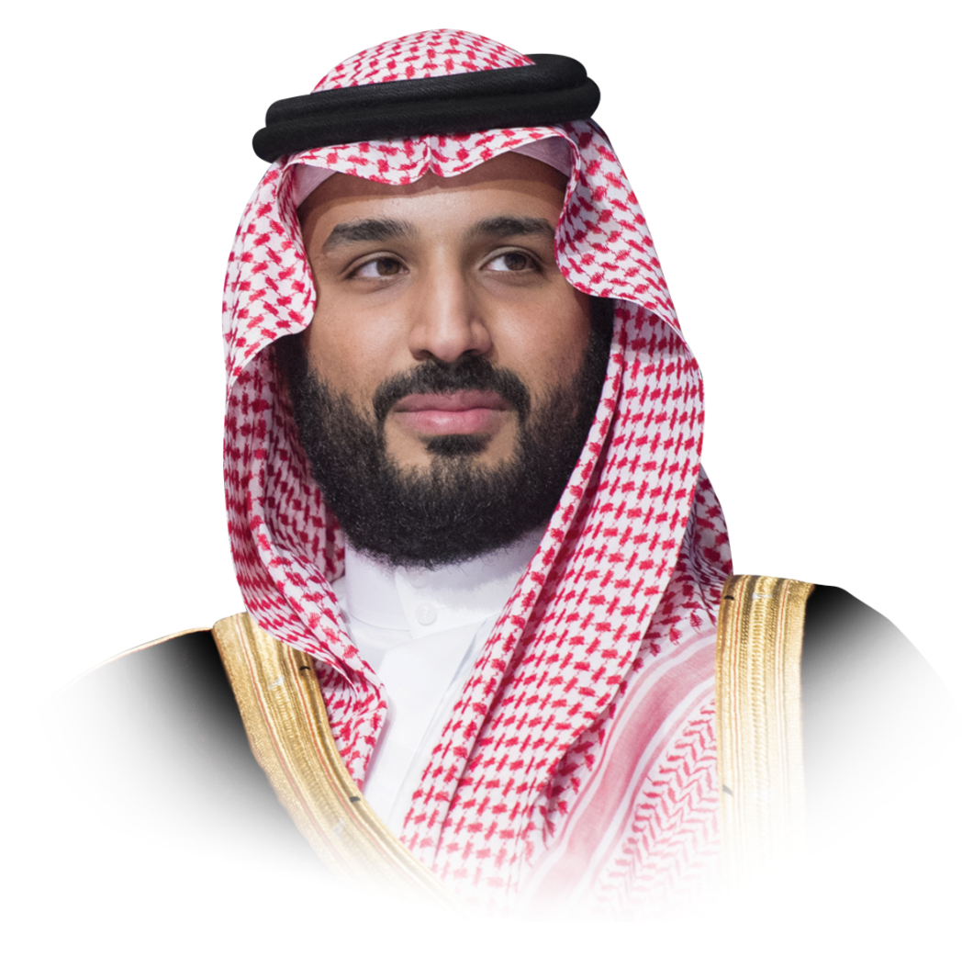
1. Professional Accreditation Overview
LEADERSHIP MESSAGE
Regarding the rights of expats, we have taken multiple measures to restructure the contractual relationship in a way that preserves their rights and contributes to raising the degree of maturity in the labor market, and to attract qualified workers with an added value to the Kingdom
The Crown Prince, His Royal Highness
Mohammed bin Salman
bin Abdulaziz Al Saud

Slide 5


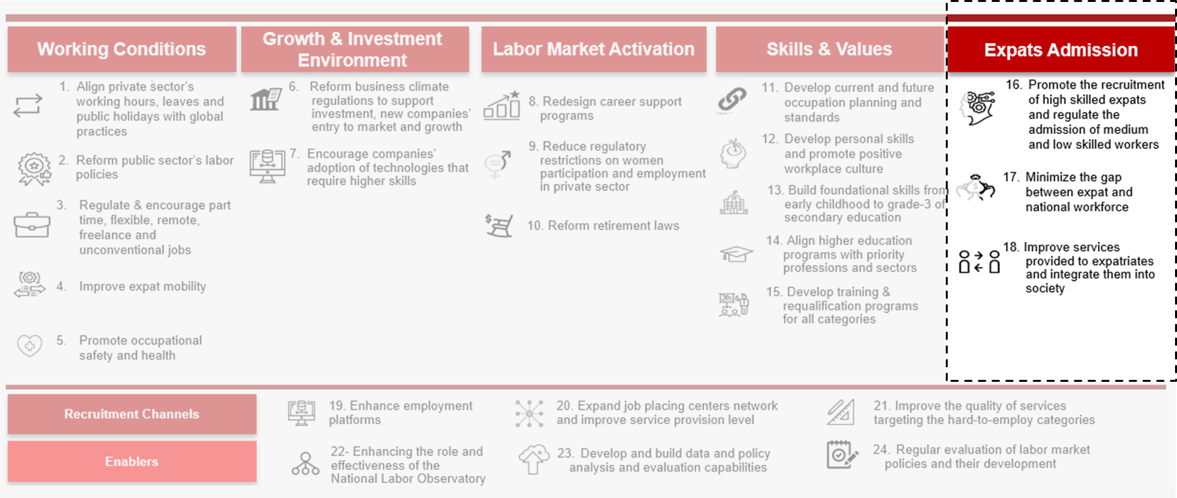
1. Professional Accreditation Overview
The Labor Market Strategy aims to promote and regulate the admission of workers
Labor Market Vision:
A dynamic labor market that strategically attracts both local and international talent, offering promising prospects for its citizens and ensuring a high quality of life. It plays a major role in facilitating the transition towards a diversified and prosperous economy, equipped with the necessary elements to effectively address present and future challenges.
Based on The Kingdom's Vision 2030’s pillar to have a “Thriving Economy“ beside the objectives of the national transformation:
Objective 27: Attracting the right global talent effectively.
Labor Market Strategy - Key Pillars and Initiatives
Expats admission :
Initiative No. 16 of the Labor Market Strategy focuses on promoting the recruitment of highly skilled professional expats and regulating the admission of medium and low skilled professional expats

Slide 6




1. Professional Accreditation Overview
Professional Accreditation Added Values
Improve quality and productivity by verifying the suitability of workers for their professions
Boost confidence and credibility between workers and employers
Access to global talent by enabling employers to attract skilled professionals from all over the world
Enhance hiring process by providing a standardized measure of competences for the employers
Recognize the capabilities by providing the workers with a recognized mark of their quality and competencies
Increase career opportunities for certified workers by raising their competitive advantage in their specialized professions
Labor Market
Employers
Workers

Slide 7


1. Professional Accreditation Overview
Two programs fall under the umbrella of Professional Accreditation
Qualification Verification Program
Skills Verification Program
QVP
SVP
Verifying the validity and alignment of the qualifications and experience of the expatriate worker with the professional requirements of the Saudi labor market.
Ensure that the expatriate professional worker have the necessary skills by performing a practical and theoretical tests in their field of specialization.
Example: Software developer
Example: Electrician

Slide 8
1. Professional Accreditation Overview
Core principles of the Professional Accreditation Framework
Sustainability
Flexibility
Incorporation of best global practices
Alignment with government regulations
Effective governance and continuous development
Consideration of academic certificates, experiences, and prior learning as different methods of verification
Provision of multiple languages for testing
Simplicity
Transparency
Worldwide application for qualifications verification
Test Centers availabilities in various states and cities
Online platform for application and tracking
Candidates have the right to appeal if they believe the verification results are inaccurate
Results inquiry service is available upon request

Slide 9
Qualifications Verification Program
2

Slide 10

2. Qualifications Verification Program
The qualification verification program is designed for highly skilled workers
Qualification verification
Program
Group Code
Name of Main group
No. of Professions
Managers
312
1
QVP
Specialists
630
2
Technicians and assistant specialists
373
3
Office Support Workers
52
4
Verifying the validity and alignment of the qualifications and experience of the expatriate worker with the professional requirements of the Saudi labor market.
Service and sales workers
109
5
Saudi Standard Classification of Occupations *
Skilled workers in agriculture, forestry & fish farms
53
6
Craftsmen and those associated with them
179
7
Plant and machinery operators & assembly workers
218
8
Primary occupations
77
Example: Software developer
9
High skills
Medium skills
Low skills
*>Based on the International Standard Classification of Occupations (ISCO-08)

Slide 11
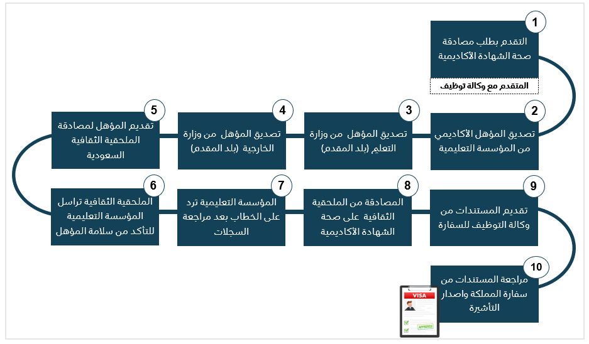



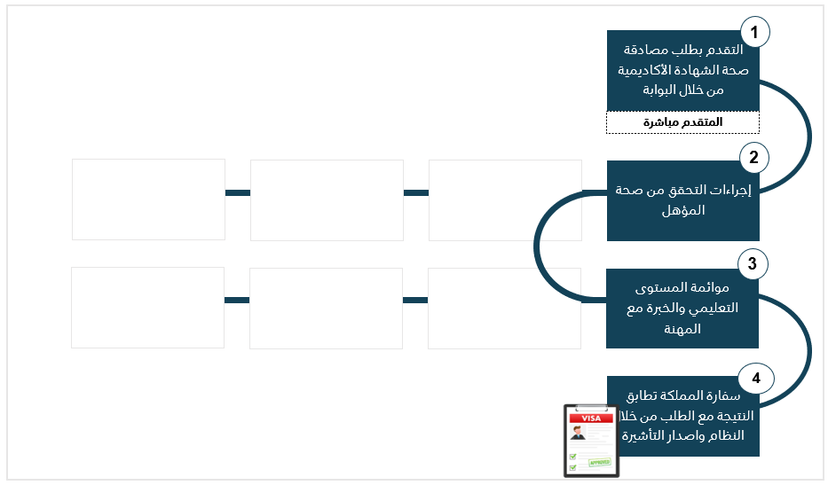
2. Qualifications Verification Program
Streamlining the Journey: Transforming the Verification Process into a Fully Automated System
Previous
Manual process in 10 steps
Diverse methodologies with varying durations
Must apply from
the country of origin
Current
Automated
process in 4 steps
Unified methodology
within 15 days
Apply from anywhere

Slide 12
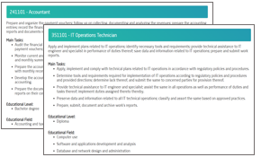
2. Qualifications Verification Program
Methodology for verifying the worker’s suitability for the targeted profession
1
Analyze profession
requirements
2
Educational
Level and Field
3
Experience as an alternative
(Launch soon)
Referring to SSCO, the technical requirements for each profession are analyzed, encompassing main tasks, educational level and field, skills, and other relevant factors
Aligning the applicant's academic degrees and its field with the profession requirements
Verifying the practical experiences and comparing it with profession requirements in case the applicant have not met the requirements (Educational level and field) of the professions
Example:
Experience related to main tasks of the profession
Accountant
Level: Bachelor degree
Field : Accounting & taxation
IT Operations Technician
Level: Diploma degree
Field : Computer / Software & applications development
SSCO: Saudi Standard Classification of Occupations

Slide 13
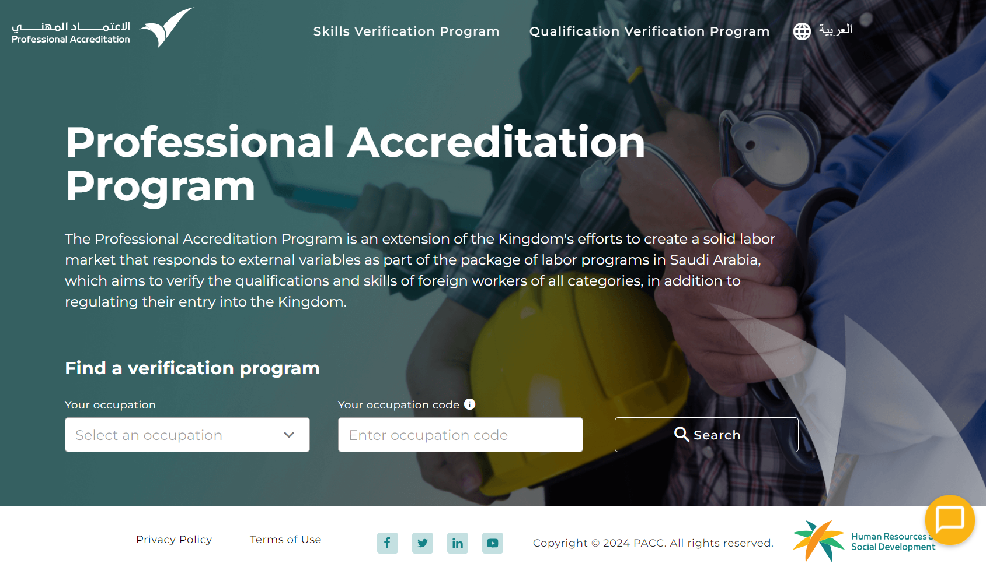
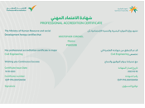





2. Qualifications Verification Program
Qualifications Verification Program Platform
Service allows the candidate to:
Creating a personal profile
Selecting targeted profession
Uploading the documents
Verification process takes up to 15 days. During this process, the candidate can track their verification request.
The candidate receives the certificate after the verification process
Provides 24/7 customer care service, with various channels:
Technical Support Tickets
Email
Chatbot
Social Media Platforms
Link
Registration
Verification
Certification
Customer care

Slide 14
Skills Verification Program
3

Slide 15
3. Skills Verification Program
The skills verification program is designed for medium and low skilled workers
Skills
verification Program
Group Code
Name of Main group
No. of Professions
Managers
312
SVP
1
Specialists
630
2
Technicians and assistant specialists
373
3
Office Support Workers
52
4
Ensure that the expatriate professional worker have the necessary skills by performing a practical and theoretical tests in their field of specialization
Service and sales workers
109
5
Saudi Standard Classification of Occupations *
Skilled workers in agriculture, forestry & fish farms
53
6
Craftsmen and those associated with them
179
7
Plant and machinery operators & assembly workers
218
8
Primary occupations
77
Example: Electrician
9
High skills
Medium skills
Low skills
*>Based on the International Standard Classification of Occupations (ISCO-08)

Slide 16


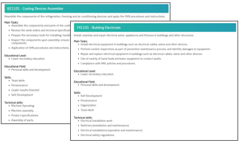
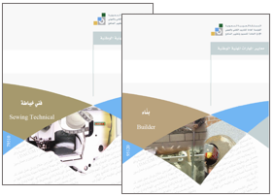
3. Skills Verification Program
Methodology for verifying the suitability of the worker’s skills for the targeted profession
Analyze the profession
requirements
2
Select standard and develop the questions
Assess the skills
through various tests
1
3
Referring to SSCO, the technical requirements for each profession are analyzed, encompassing main tasks, educational level and field, skills, and other relevant factors
Select the best fit standard that cover profession scope and requirements
Develop the questions banks for the theoretical and practical tests by SMEs
Theoretical Test:
To assesses the worker's knowledge and understanding of the concepts and principles of the targeted profession
Practical Test:
To evaluate the worker’s hands-on skills and abilities to carry out the related activities of the targeted profession
SSCO: Saudi Standard Classification of Occupations

Slide 17
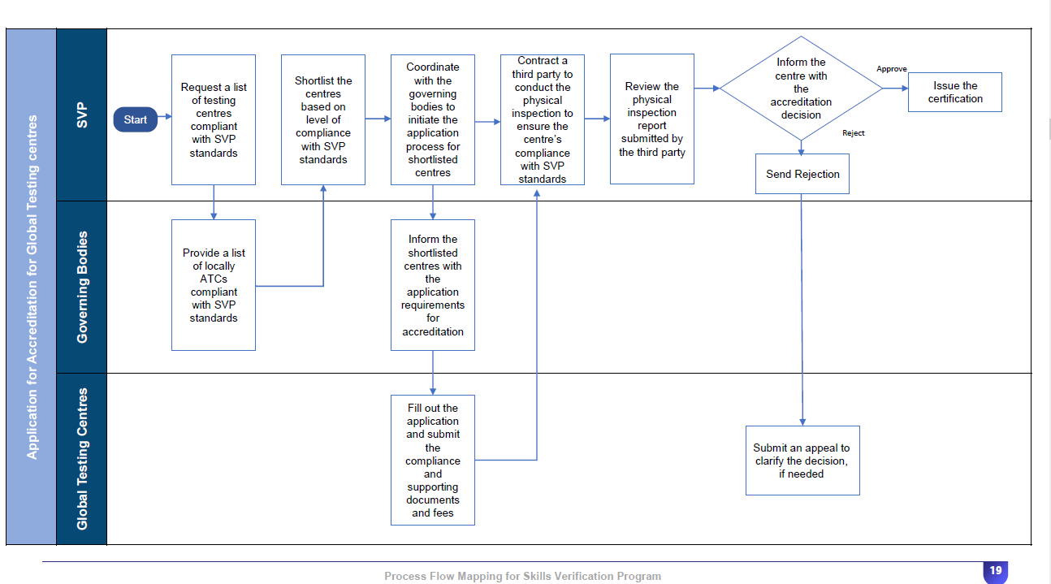
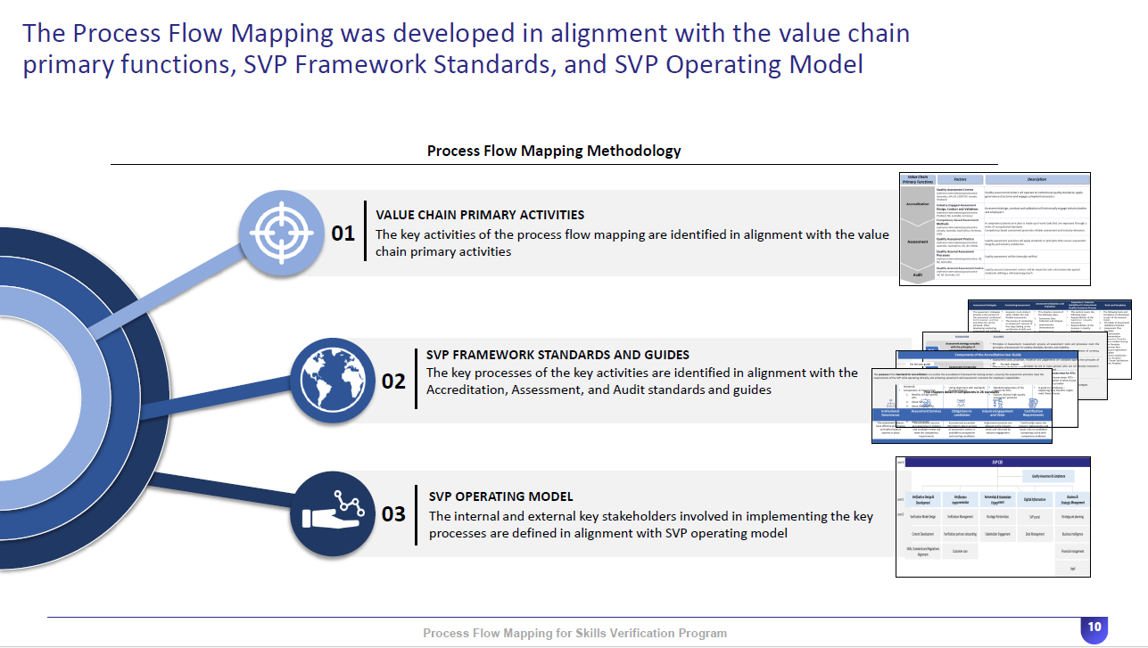
3. Skills Verification Program
Test Centers Accreditation Standards
Detailed framework model for comprehensive standards, to ensure that the level of services provided during the applicant journey
Facility Requirements
Institutional Governance
Testing
Services
1
2
3
9 requirements
Entrance and external sign
Waiting area
CCTV Cameras
Theoretical test rooms
Practical test rooms
Desk space (workstation)
Emergency exits.
16 requirements
TC staff necessary competence
Internal validator
TC organizational structure
local building codes
Appeals and complaints
Data confidentiality
Data archiving
19 requirements
Candidate identification
Assessors' development record
Lab's restriction
Test instructions
Testing tools condition
Examination materials
Assessor availability during sessions

Slide 18



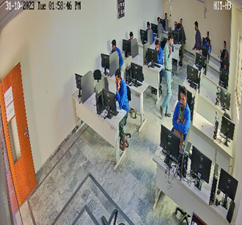
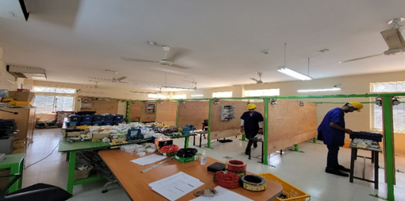
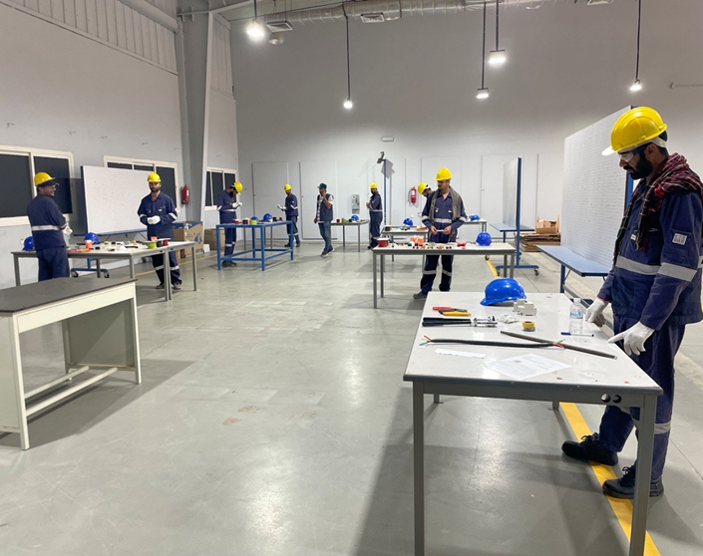
3. Skills Verification Program
The Quality and Compliance activity are measured through 3 tracks
Sessions Monitor
Inspection visits
Randomized
Quality Checks
Monitoring theoretical and practical test sessions and evaluating the centers' adherence to standards, in addition to ensuring compliance with the required forms.
Monitoring the performance of test centers through the implementation of field visits to ensure compliance with the requirements and standards of the program.
Conducting examinations on samples of workers arriving to KSA from various countries and testing centers to assess the quality of program implementation.

Slide 19
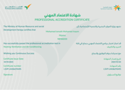


3. Skills Verification Program
Skills Verification Program Platform
Service allows the candidate to:
Create a personal profile
Select targeted occupation
Book a suitable exam
Track a status of the exam results
Evaluation of the candidate skills through (Theoretical and Practical) tests
Issuing the Certificates for the passed candidates with a validity for up to 5 years
Provides 24/7 customer care service, in different channels:
Technical Support Tickets
Email
Chatbot
Social Media Platforms
Link
Registration
Verification
Certification
Customer care

Slide 20
Communication and Awareness
4

Slide 21
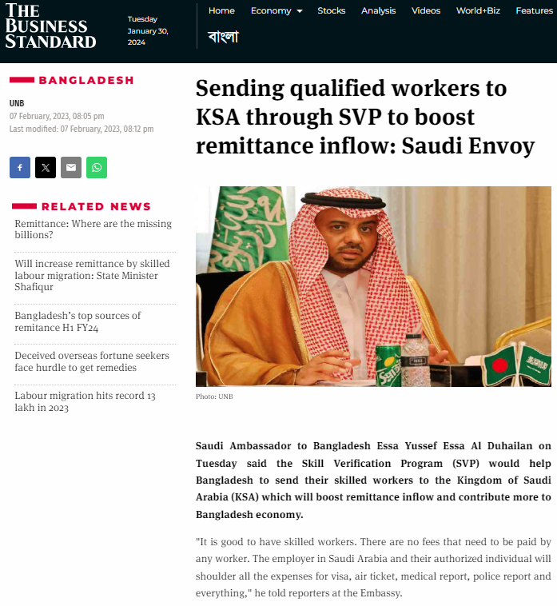
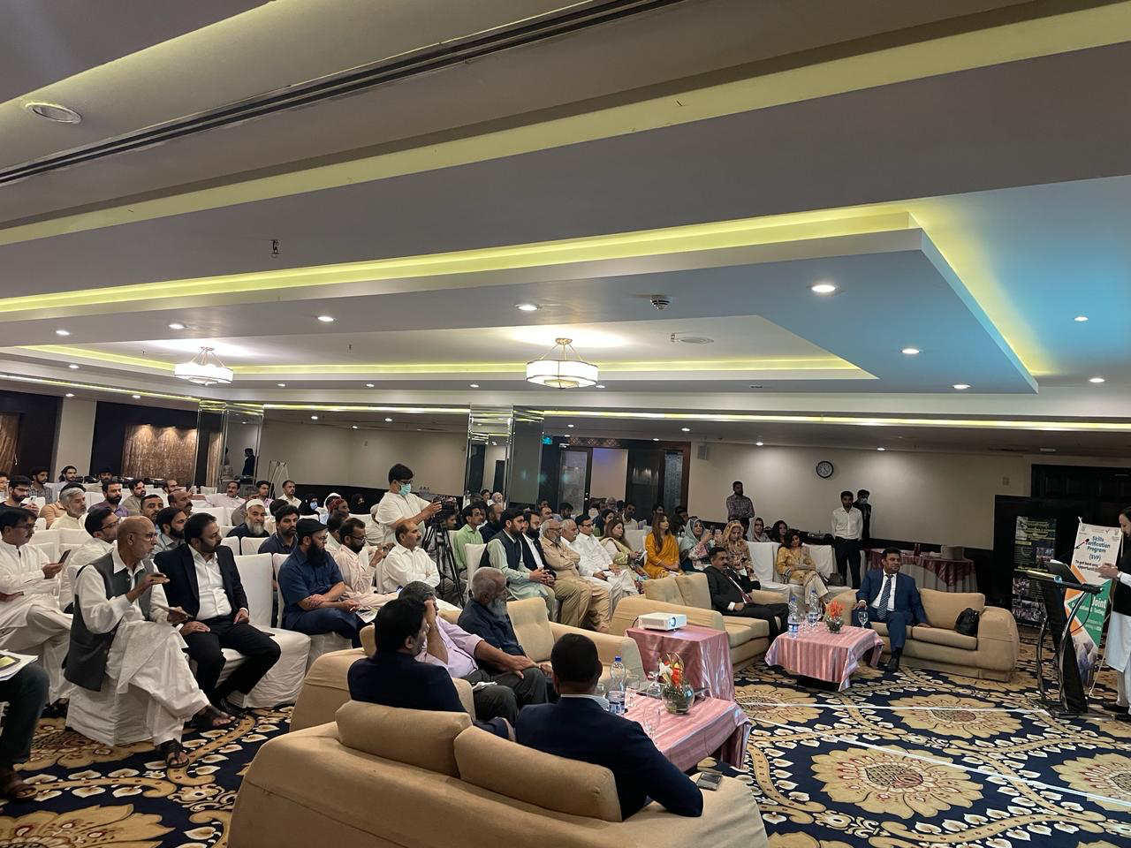

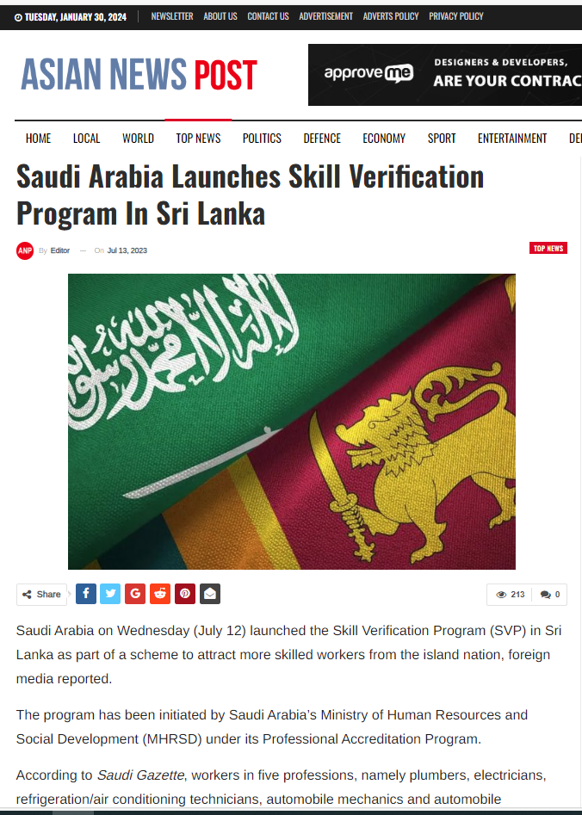

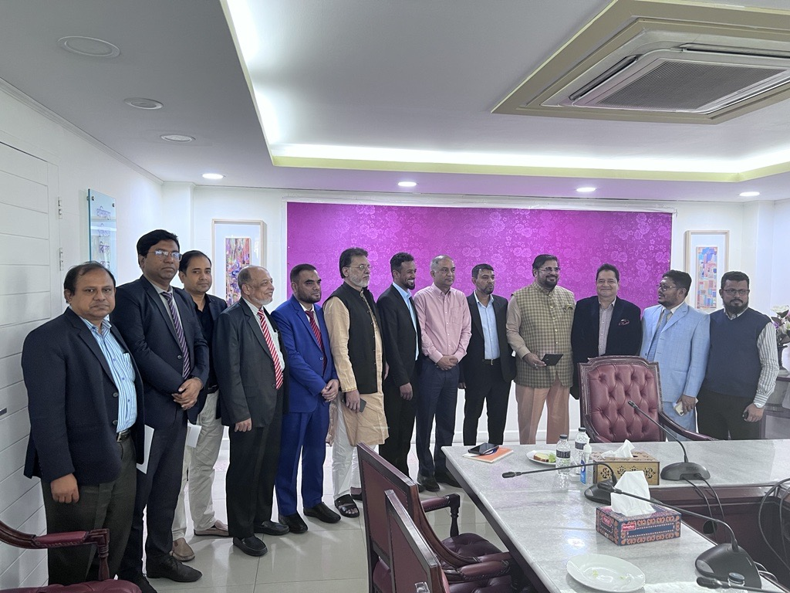
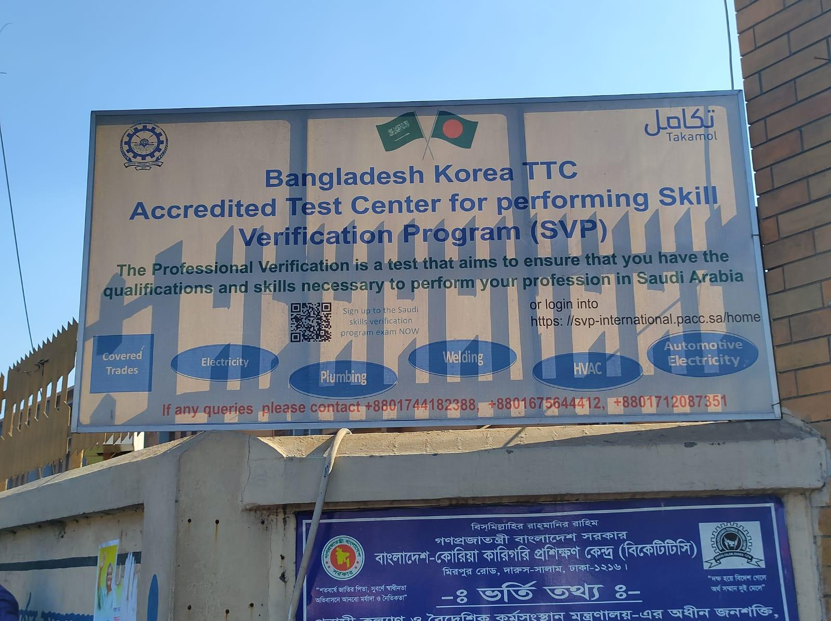
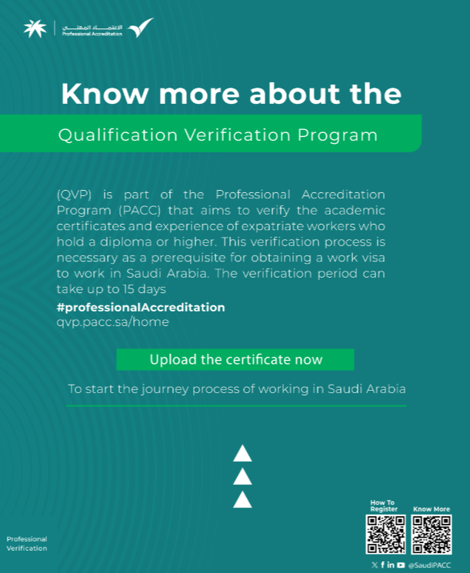
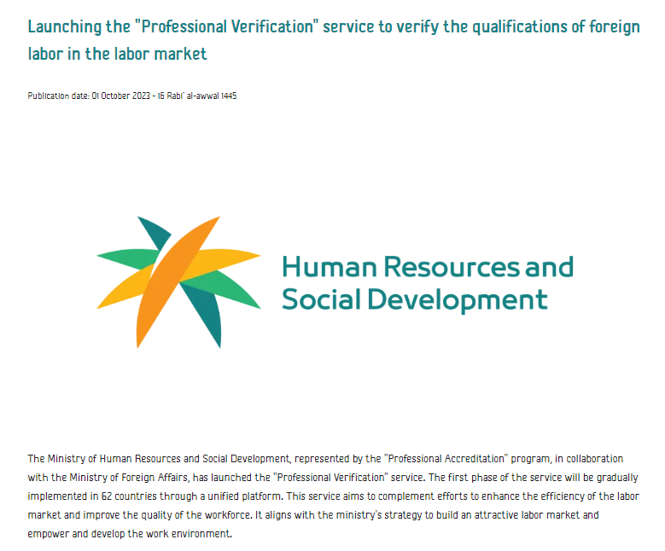
4. Communication and Awareness
Communication and Awareness Through Several Channels
Advertisement in
newspapers
Onsite Workshops
and Panners
Social media
platforms

Slide 22
Current Status and Next steps
5

Slide 23
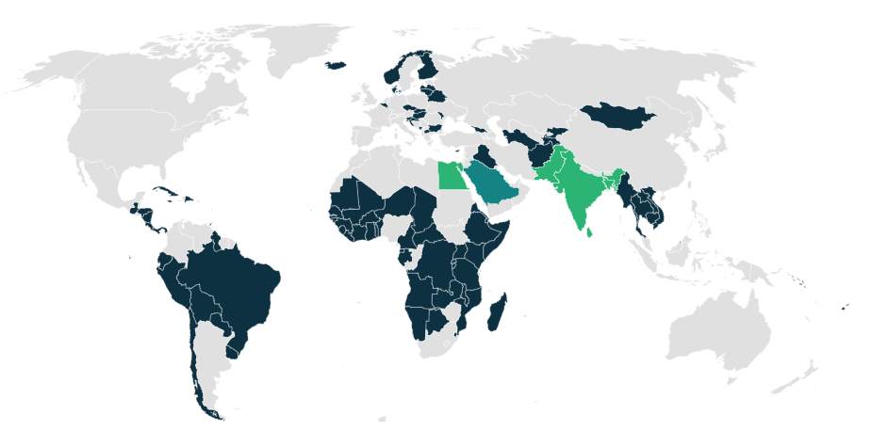

5. Current status
The Professional Accreditation is activated in 107 countries
Qualifications Verification Program
Skills Verification
Program
QVP
SVP
102 countries
79%
of demand covered
1,007 professions
134 Professions
(Medium skill) that covers 32% of the worker's flow
10.5 days
average verification days
63 test centers
globally in 39 cities
and 50 test centers locally

Slide 24
5. Next steps
The future of Professional Accreditation
Qualifications Verification Program
Skills Verification Program
QVP
SVP
Expand to 159 countries
Expand to 87% of demand covered
Increase professions to 1,315
which covered 100% of the worker's flow
Increase professions to176
which covered 91% of the worker's flow (Medium skill)

Slide 25
Thank You

