Slide 1

The Future of Domestic Work in the GCC
Marie Jose Tayah (IDWF) & Hadi Assaf (Consultant)
Research commissioned by the Secretariat of the Abu Dhabi Dialogue among the Asian labour-sending and receiving countries
Senior Officials’ Meeting in Colombo, Sri Lanka on 8-9 May 2018

Slide 2
Global debate: Future of work, future of domestic work
Caring jobs require social interaction, empathy and judgment and therefore cannot be automated (World Bank 2018).
Demand for occupations like childcare, early-childhood education, cleaning, cooking, and gardening will grow, creating 50 million to 90 million jobs globally (McKinsey Global Institute 2017).
Growing female labour force participation rates plus Demographic transformations: longer life expectancy, lower fertility and a growing old age dependency ratio.
Growing share of people in need of paid (professional and non-professional) long-term care.
An ever expanding deficit in health care workers. Deficit was 7.2 million in 2013. Expected to reach 12.9 million by 2035 (WHO 2013)
Out-patient care in private homes, especially in the case of long-term and post-operative care.
Care site-shifting has lead to task-shifting: specialized nurses assume the role of doctors. Domestic workers assume the role of unregulated nurses.

Slide 3



Research questions and scope
Questions:
Where is the GCC from these global transformations?
What are implications for the management of human resources (DW)?
Research aims to:
Examine the size and composition of the DW sector at national and GCC levels.
Examine the demand in the DW sector: determinants and structure.
Analyze the current state of affairs in employer-domestic worker matching (examples from Abu Dhabi and Dubai in the pre Tadbeer Center phase)
Reflect on human resource decisions concerning the domestic work sector in the countries of the GCC.

Slide 4

A. Domestic work is a significant sector of the GCC economy and growing

Slide 5
3.77 million domestic workers
In 2016, GCC countries hosted around 3.77 million domestic workers, 1.65 million of whom (or 44 per cent) were women.
Of the remaining 1.54 million men domestic workers, 73 percent were employed, mainly as drivers, in Saudi Arabia.

Slide 6
Domestic workers as a percentage of migrant workers

Slide 7
35,970 new domestic workers every year
Annual growth rate in the number of domestic workers is 8.7 per cent (or 35,970 domestic workers).
If we exclude Saudi Arabia, the annual growth rate in the number of domestic workers is 8.2 per cent (or 11,400 domestic workers).

Slide 8
B. Explaining the demand for domestic workers: Two trends.

Slide 9


Two explanations
Demand among nationals
Demand among expatriates
Increasing care pressures on national households due to higher FLFPRs combined with growing child and elderly care needs in national contexts where care is traditionally the responsibility of women in the family and where intergenerational households are being replaced by nuclear households.
A growing population of dual wage-earning expatriate families with child care needs and a demand for professional housekeepers who require little supervision.

Slide 10
B1. Explaining the demand for domestic workers: National Households

Slide 11
Familializing and de-familializing child and elderly care policies
Familializing care policies (providing incentives for care by the family) | Time rights: such as parental leave or care leave. Part-time work Long leaves (negative influence on reintegration into the labour market). Cash benefits: survivor’s pension or free membership of the spouse’s health insurance plan; parental leave benefits or care leave benefits.
De-familializing care policies (de-incentivizing care by the family) | Day care: long and flexible opening hours, easy access to care facilities (high supply and low costs), and a high quality of care provision. Residential or partially residential care facilities for the elderly. Dense network of ambulatory care services for the elderly:
Source: Adapted from Leitner 2003.

Slide 12
GCC: Familializing or de-familializing?
The majority of child care policies are familializing, in the form of time rights, part-time work and long leaves.
De-familializing child care policies are now effective in the UAE, Saudi Arabia and Kuwait (in the form of workplace crèches) among public sector employees.
Dense network of ambulatory elderly care services in Bahrain, Oman, Saudi Arabia and the UAE, but only where no relatives exist.
Saudi population (65 Years and over) by age group and those who help them in their daily needs, 2016 / Elderly Survey 2016 - Saudi Arabia General Authority for Statistics
Age Groups | Assistance Provider
 | Nurse | Friends\Other relatives | Family member | Total
65 – 69 | 2,094 | 1,776 | 31,660 | 35,530
70 – 74 | 1,984 | 1,318 | 38,415 | 41,717
75 – 79 | 4,859 | 618 | 29,588 | 35,065
80+ | 10,328 | 2,484 | 62,849 | 75,661
Total | 19,265 | 6,196 | 162,512 | 187,973

Slide 13
Female labour force participation rates among nationals are growing

Slide 14
High and growing life expectancy and high and declining fertility
Fertility Rate
Life Expectancy

Slide 15
Life expectancy and fertility by country
Fertility rate
Life expectancy
Fertility rate
Life expectancy
2.9

Slide 16
Life expectancy and fertility by country (cont’d)
Fertility rate
Life expectancy
Fertility rate
Life expectancy

Slide 17
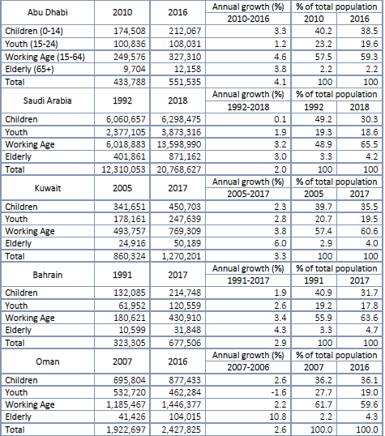
Children constitute 34 per cent of the total national population
Despite declining over time, the share of children among national population is high. Children (ages 0-14) – those who are in need of quality care – constitute 34 per cent of the total national population.

Slide 18
B2. Explaining the demand for domestic workers: Expatriates’ Households

Slide 19
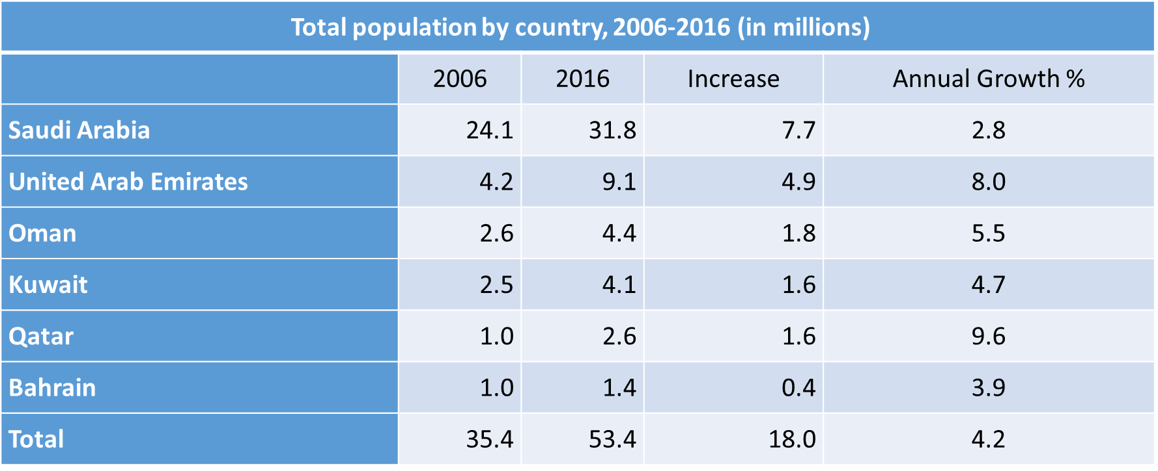
Total population has increased by 51 per cent (4.2 per cent annually)
Over the past decade, the total population of the GCC countries has increased by 51 per cent (by 18 million) or by 4.2 per cent annually.
On average, the national GCC population increased by 2.7 per cent annually.

Slide 20
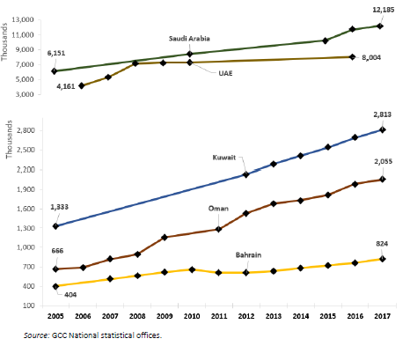
Population growth is driven by expatriates
Population growth is driven by expatriates of whom a significant number are dual wage earners who need and can afford the services of domestic workers to perform child care, tutoring, housekeeping and cooking functions.
Average monthly household income in GCC countries (USD)
 | Nationals | Non-Nationals | Total | Year
Qatar | 24,235 | 6,707 | 11,430 | 2013
Dubai | 19,671 | 7,656 | .. | 2014
Kuwait | 11,148 | 3,126 | 6,448 | 2013
Bahrain | 4,728 | 3,838 | 4,421 | 2015
Saudi Arabia | 3,629 | .. | 2,859 | 2013
Oman | 3,049 | 1,693 | .. | 2012

Slide 21
C. Current state of affairs in employer-domestic worker matching: Examples from AD and Dubai (pre-Tadbeer phase)

Slide 22

Scope
Map how the market is structured in the UAE;
Examine modalities of employer-domestic workers matching among placement agencies in the UAE; and,
Assess the demand for skilled workers among employers and the need for skills training among domestic workers in the UAE.

Slide 23
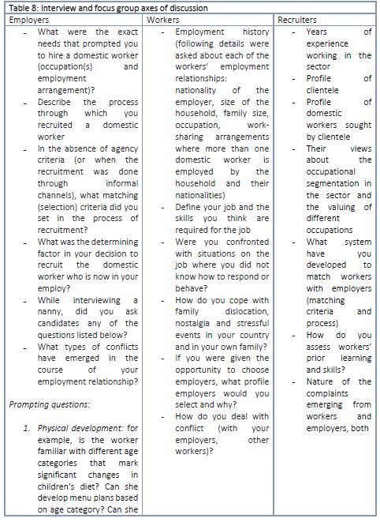
Methodology
Interviews with 10 Tadbeer operators.
Interviews with 82 domestic workers.
2 FGDs with DWs.
2 FGDs with employers.

Slide 24
How is the demand for domestic workers structured?
Despite the diversity of Tadbeer operators and their experience, there is general consensus among them that the demand is highest for “housemaids” (who are also nannies and cooks), followed by nannies and then cooks. Nannies are the highest paid category (USD 500) among the three, followed by uncertified cooks (USD 400) and housemaids (USD 320-408).
The demand was less significant for the remaining categories (tutors, private nurses, gardeners, watchmen, family drivers, housekeepers, personal assistants and farmers) because employers generally recruit them directly without the intermediation of labour recruiters. The latter are higher-skilled occupations and, in the absence of NOS, certification and proper matching processes, employers prefer recruitment through informal networks where they can verify candidates’ references (in the case of informal education) and credentials (in the case of formal education).

Slide 25
Matching modalities
Example of video content circulated by placement agencies via social media applications
Placement agencies circulate videos via social media. These are short videos (under two minutes) during which a recruiter asks a domestic worker the following questions (verbatim): “Your name Age Are you married? Do you have children? What is your employment history? (Usually referring to countries she has worked in as domestic worker before arriving in the UAE). Can you clean? Can you cook? What meals can you cook? Can you “hold” a baby? Can you prepare deserts? Which?”
Using social media platforms like WhatsApp or Facebook.
Online lists of matching criteria mixing identity and occupational identifiers which employers can use to shortlist potential candidates.
Interviews with the workers (usually unidirectional, with the employer interviewing the worker).
Direct selection by labour recruiters without employer input or based on earlier intake with employers.
Agency criteria that employers are invited to select in order to shortlist workers for interviews
These are the matching criteria used by one of the placement agencies, now a TSC. “Please tell us about yourself. You have: A preference for a Filipino maid A requirement for a Muslim maid A cat A dog Fondness for western food A preference for an Ethiopian maid A special needs child Fondness for Arabic food Fondness for Asian food An infant (new-born to 2 years) A child between 2 and 16 years An elderly parent”
Source: Maids.cc Tadbeer Service Center.

Slide 26
Matching modalities (cont’d)
Composite index of labour matching dimensions among recruiters
Personal/physical attributes | Nationality. Religion. Age: According to recruiters, 40-50 is the most desirable age category because workers have fewer family responsibilities and are less distracted by personal issues. Second best performing age category, according to recruiters, is women aged 30-40 because they possess the level of maturity required for the job. Height and weight are determining factors in the case of elderly caregivers or caregivers for people with disabilities.
Experience | Ability to cook a certain style of food (Western, Asian, Mediterranean…). Caring for special needs child (especially violent autism). Pet minding skills. Post-natal care skills, especially in the case of twins. Caring for the elderly.
Family status | Marital status (a recent divorce or separation are viewed as distracting and therefore divorcees are avoided by labour recruiters). Mothers with children below the age of 7 are also avoided by recruiters. They are thought to affect worker retention and focus on the job. Mothers with children are sought-after for childcare arrangements because of their experience in raising children of different age categories.
Three categories of shortcuts in the matching process; personal and physical attributes, experience, and family status.

Slide 27
Matching modalities (cont’d)
Stereotypes and assumptions by:
(a) employers about work performed by women from different nationalities;
(b) workers about employers from different nationalities and religious backgrounds;
(c) workers about other workers from different nationalities;
(d) labour recruiters about employers from different nationalities; and,
(e) labour recruiters about domestic workers from different nationalities.

Slide 28
Hidden assumptions
Western Expats: Class guilt and cleaning after oneself ideal
Arab expats: Compensating for the need to “outsource” care with close supervision
“I personally like to do things myself; I also do not like the idea of a person depending on me…what happens when my children grow older and I have to terminate her contract” (American employer in Abu Dhabi).
“I am not comfortable telling her (the domestic worker) what to do, so I just let her be” (German employer in Abu Dhabi).
“Nationals and Arab expatriates are micro-managers. They monitor us closely. We prefer to work with Western expats. They trust us with the work and let us manage our time” (Focus group with domestic workers in Dubai; also confirmed in Abu Dhabi).
“Parents do not want to admit to hiring a nanny because it is their job and do not want to be judged by relatives for delegating their caregiving responsibilities” (Labour recruiter in Dubai).

Slide 29
Skills and prior learning assessment modalities
Timing and type of agency skills’ assessment and skilling interventions
Timing of intervention | Type of intervention
Pre-departure checks | This is achieved via interviews in the country of origin and through the verification of their Facebook chatter. Previously, labour recruiters set up “training camps” to train domestic workers pre-departure. Training camps were an “opportunity to weed out workers who did not demonstrate the skills and competence required for the job before deployment.” These programmes have now been replaced by national programmes.
On-arrival, pre-placement trainings | Only two of the labour recruiters interviewed provided trainings in “UAE model villas” before placing workers. Training is limited to housekeeping and cooking.
On-arrival trial-and-error placement | Most recruiters consider trial periods and, in the words of two labour recruiters, “endless worker replacement possibilities,” a solution to poor matching.
On-the-job trainings | One labour recruiter is providing custom-made trainings in employers’ household (for an employer-paid fee). The “Training and Management package” lasts 12 months and is divided into 12 weekly testing modules, offering three hours of in-house training each month.

Slide 30
Demand for Skills: Employers
A demand for vocational and transversal skills but also for skills that reduce the transaction cost of recruitment and the emotional cost of parting with the worker.
Examples (transaction cost reducing skills):
  employers look for domestic workers with experience working with children of different age categories so as not to hire a new work when the children’s developmental needs change;
  employers seek workers who can adjust their time management and upgrade their vocational skills when they move to larger homes with fancier finishing, furniture and household appliances, usually entertaining at a higher frequency.

Slide 31
Demand for skills: Workers
A need for skills relating to employment arrangements, self-preservation skills and vocational skills.
In relation to employment arrangements (on-demand arrangement):
  (a) adjust to different households of different sizes, with different dynamics and work-sharing arrangements each time (sometime during the same day); (b) manage relationships with multiple employers of different nationalities and distinct household cultures; (c) manage their time better (they do not have the luxury of parsing out the tasks over a full day or week); (d) manage stress and work pressures to avoid burnout; and, (e) develop strategies to deal with repetitive movements which can cause muscle strain injuries.

Slide 32
Recognizing workers’ employment history and providing opportunities for mobility within the sector
Domestic workers in the UAE gain new skills on the job that allow them to move:
  From: low-wage, nanny only, housekeeper only and cook only, closely-supervised live-in employment arrangements in large households
  To: higher-waged housekeeping or nanny-only (or both) live-out arrangements where they are rather autonomous in carrying out their tasks.
  These skills are not formally recognized under the current system. The transition depends on the worker’s social network among employers, communication skills and individual bargaining capacity.
  Workers unable to transition through employer networks, sign up for on-demand cleaning employment arrangements hoping to find, in the process, a suitable employer who will provide them with the higher wage, lower workload, more autonomy, live out employment arrangement.

Slide 33
D. Reflecting on the way forward

Slide 34

The way forward
reflecting on what the longer-term demand in the sector means for a labour admission system for domestic workers;
developing national benchmarks or occupational standards that capture the segmentation within the sector;
developing, assessing, and recognizing workers’ skills against a national benchmark to better match employer expectations with worker qualifications and to improve the quality of the services delivered to employers, especially those related to child, elderly and post-operative care where developmental, safety and hygiene protocols are paramount;
promoting workers’ mobility within the sector (from lower to higher complexity tasks) in accordance with these same benchmarks; and,
progressively moving away from the nationality-based wage differentials to a waging system modelled after the benchmarks.

Slide 35
Suggestions for the way forward:
Linking wage increases to complexity in the sector and tying labour admission to skill certification or to recognition of prior learning (RPL) systems.
Developing regional competence standards (RCS) to recognize the regional mobility of domestic workers and to transition from the logic of “facilitating market access based on nationality” to the logic of “harmonized, transparent and efficient labour matching.”
Tying RCS to regional skills passports for domestic workers to recognize the experience of workers who are mobile within the GCC and progressively promote the recognition of these passports for returning domestic workers (in the GCC-Asia or GCC-Africa migration corridors).
Expanding the discussion on RCS (and corresponding wage levels) to organizations representing relevant interest groups (e.g., groups and government agencies representing the interests of families, the elderly, women, migrant workers, children, and people with disability) to garner support for these standards and to revise and adjust them in light of local economic factors and the needs of migrant domestic workers and their families.

Slide 36
EXAMPLE: Job classification of domestic workers and carers in Italy (CBA 2013)
Level A
  Domestic workers with no experience
Level B
  Assistants to self-sufficient individuals
Level C
  Individual assistants to non-self-sufficient individuals, unskilled
Level D
  Individual assistants to non-self-sufficient individuals, trained and skilled (highest earning category)

Slide 37





EXAMPLE: Job classification of private household personnel in Argentina (CBA 2013)
  Supervisors: personnel hired to coordinate and supervise the tasks of two or more domestic workers.*
  Cooks: personnel hired exclusively to cook.**
  Caseros/as: live-in personnel performing tasks for the preservation of the dwelling
  Caregivers: personnel providing non-therapeutic assistance and care to children, elders, the sick and people with disability. ***
  Personnel for general tasks: personnel hired to perform a number of household tasks such as cleaning, washing, ironing, maintenance, preparing and cooking meals.

Slide 38







EXAMPLE: Job classification of domestic workers in Hong Kong SAR, China
General cleaning | 10 USD/hour.
Special / intensive cleaning | 14 - 16.6 USD/hour
Post-natal care | 2,250 USD/month

Slide 39
EXAMPLE: Regional Model Competency Standards for Domestic Work in ASEAN (ILO 2014)
Core competencies | A1. Communicate effectively in a domestic work environment; A2. Work in a socially and culturally diverse workplace; A3. Maintain health, safety and security in a domestic work environment; A4. Plan, organize and manage own work; A5. Undertake calculations relevant to domestic work; and A6. Use a language other than the local language to communicate in a domestic work setting.
Domestic cleaning and basic housekeeping | B1. Apply basic cleaning principles to perform cleaning tasks; B2. Clean and maintain bedrooms and living areas; B3. Clean and maintain bathrooms and toilet facilities; B4. Wash cloths, linens and fabrics; and B5. Iron and store laundered items.
Cooking and food handling | C1. Clean and maintain food preparation, storage and service areas; C2. Follow basic food safety practices; C3. Organize and prepare basic food in a domestic setting; and C4. Serve food and beverages.
Care for infants and children | D1. Work effectively with families to provide care and support for infants and children; D2. Provide care and support for the infants and/or toddlers in a household; and D3. Provide care and support for children in a household.
Care for elderly people | E1. Provide support to elderly people to meet personal care needs; and E2. Assist client with medication.
Care for household pets and plants | F1. Provide care for pets in a household; and F2. Provide care for plants in a household.

