Slide 1

Skills in-need for the future of work and the role of human mobility
Guidelines for designing successful skills partnerships
Jason GAGNON
Head of unit
Abu Dhabi Dialogue
Ministerial Consultation

Slide 2

The global talent shortage risks the digital and green transitions
Global human talent shortage by 2030:
85 million
(Korn Ferry 2018)
(ManpowerGroup 2023)
71% in Energy and Utilities companies
Analytical thinking
Creative thinking
Resilience & Adaptability
Motivation & Self-Awareness
Curiosity
Technological literacy
(WEF 2023)
Core Skills 2023
(Wiley 2021)
7 million people
will be missing by 2030 in the green economy
(BCG 2023)

Slide 3

Skilled labour is constrained in the GCC workforce
High demand for
analytical, planning, and supervisory roles
(PwC 2023, Misk academy 2020)
57%
Engineering degrees are the
of ME workforce say
green skills will be more important
(PwC 2023)
2nd most sought-after qualification
(Bayt.com and YouGov 2023)
50% of CEOs in the Middle East warn that
labour / skill shortages will impact profitability
(PwC 2023)
Notes:
employment in analytical, planning, and supervisory roles are experiencing great demand

Slide 4

There is room for growth through more investment in digital skills in GCC countries
Only 40% of students
study high-demand qualifications
in Saudi-Arabia
(Misk Academy 2020)
77% of IT decision-makers
in the UAE view this shortage as a
threat to their business
(Equinix 2022)
“Only one of the 10 skills
GCC digital professionals cite most commonly matches the fastest-growing skills globally” (strategy&, 2017)
UAE
46%
KSA
58%
QAT
60%
KWT
75%
“Respondents who believe their country has a shortage of people with specialised skills”
(PwC 2022)
Notes:
At least in the UAE, 77% of IT decision-makers view this shortage as a threat to their business (Equinix, 2022_{[34]}).

Slide 5
BROADLY DEFINED SKILLS MOBILITY SCHEMES
TVET programmes
Education exchange programmes
Skills Mobility Partnerships
Short-term employment opportunities in partner countries
Education qualification recognition frameworks
Seasonal work mobility programmes
One-year university placement programmes

Slide 6




WHY CREATE SKILLS MOBILITY SCHEMES?
Skills mismatch in labour market is worsening
  SMSs can fill labour and skills shortages in specific sectors in both countries of origin and destination.
Regularize migration
  Address concerns about the impact of migration on both sides.
Skills mobility schemes (SMSs) allow for:
  Shared migration costs and benefits
  Additional legal migration pathways
  Larger skills pool in both countries of origin and destination
  Better training capacity in countries of origin
  Flexibility
  Alignment of skills with labour markets (demand-driven)
Notes:
European Commission (2010), “one of the main problems is the mismatch between the outcomes of the educational system and the qualifications required on the job market” (Anneleen Vandeplas, Anna Thym-Thysen, 2019. “Skills Mismatch & Productivity in the EU,” European Commission, Discussion Paper no. 100, July.)
Worsening skills mismatching in labour markets, in the EU and across the world
European Commission (2010), “one of the main problems is the mismatch between the outcomes of the educational system and the qualifications required on the job market”
In 2015, “around 39% of the EU firms were facing difficulties in finding staff with the right skills”
European Commission (2010), “one of the main problems is the mismatch between the outcomes of the educational system and the qualifications required on the job market” (Anneleen Vandeplas, Anna Thym-Thysen, 2019. “Skills Mismatch & Productivity in the EU,” European Commission, Discussion Paper no. 100, July.)
In 2015, “around 39% of the EU firms were facing difficulties in finding staff with the right skills” (Ullah, A.K.M.A., Mohamad, S.M., Hassan, N.H. and Chattoraj, D. (2019), "Global skills deficiency: perspectives of skill mobility in Southeast Asian countries", Asian Education and Development Studies, Vol. 8 No. 4, pp. 416-432. https://doi.org/10.1108/AEDS-12-2018-0185)

Slide 7
BENEFITS OF SKILLS MOBILITY PARTNERSHIPS
Host Country
Country of Origin
Address labour market mismatch
  Skill shortages
Regularising migration: reap the benefits of labour migration
Decrease Unemployment
Increased human capital through skills transfer
Remittances
Both: Improved communication on public policy in the areas of migration, labour markets, education and training
Migrant
Improved skills sets
Improved career prospects

Slide 8
Migration can contribute to enhancing development in countries of destination
Immigration helps reduce skills mismatches
Immigrants expand the domestic market
Immigrants contribute to financing social protection systems
Immigration can lead to increased innovation & entrepreneurship

Slide 9
WHAT ARE THE PRACTICALITIES OF PUTTING TOGETHER AN SMP?
Pre-SMP
Assessment of labour market skills shortages and demand in CoO and CoD
Creation of SMP
Coordination between co-operation development agency and employment agencies in partner countries
Collaboration with private sector
Inclusion of diaspora organisations and communities in programme design
During SMP
Adjustment of migration systems (creation of new pathways for migrants)
Regular communication between all stakeholders involved in the SMP
Post-SMP
Reintegration in CoO
Review and evaluation of SMP

Slide 10
REVIEW OF SKILLS MOBILITY SCHEMES
Collection of information and data on skills migration schemes
  Global Skills Partnerships database
  EMN-OECD report, March 2022
  MPF website
  IOM and ILO websites
  National government websites
Objective
  Create a database of SMSs that are ongoing or were active from 2010-2023
  Breakdown their ingredients, the commonalities, the divergences, distil different practices
    Investigate the developmental impact of SMSs in CoO
  Provide the SMP and GSP community with additional material on which to base their own programming (including on development of CoO)

Slide 11



Overview of the Database
CoD : Germany (16), Belgium (6), Italy (5)
CoO :
Africa: Tunisia (13), Morocco (9), Nigeria (5)
Asia: Viet Nam (7), India (7), The Philippines (5)
Interregional: 44
Regional: 12
Budget: Can reach €125 million
Participant size: 8 → 400 000

Slide 12

Distribution of SMSs by region of destination
Total: 56
2
43
6
1
5

Slide 13
Distribution of SMSs by region of origin
Total: 56
1
7
23
29
7
5

Slide 14
There is an increasing number of SMSs

Slide 15
HOW ARE SKILLS MOBILITY SCHEMES SIMILAR? HOW DO THEY DIFFER?
Bilateral labour migration agreements different from traditional migration recruitment systems because they combine migration policies with skills development and recognition policies, involve partnerships at different levels and imply mutual benefits.
No single model of partnership prevails, but all SMSs possess the following components:
However, SMSs will necessarily vary in terms of:
Formalised State cooperation, often between different ministries
Multi-stakeholder involvement, including the private sector, training institutions, international organisations and local institutions
Skills development, including technical and vocational training, university courses, internships, pre-departure training and/or soft skills training
Skills recognition, through the implementation of training standards
Mobility, in most cases for an internship/ traineeship
Cost-sharing structures;
Location of training;
Targeted sectors;
Targeted skills and skill levels;
Partners involved;
Implementing partner/s;
Responsibility for curriculum development;
Selection process for participants;
Responsibility upon return
Notes:
What is common across skills migration schemes, and how do they differ?
Mobility, in most cases for an internship/traineeship
Formalised State cooperation, often between different ministries
Multi-stakeholder involvement, including the private sector, training institutions, international organisations and local institutions
They often operate within pre-existing frameworks, and build on them
First three paragraphs
They require data and data partnerships (and therefore, trust)
They try to build a business case that involves several stakeholders
Skills development, including technical and vocational training, university courses, internships, pre-departure training and/or soft skills training
They administer pre-departure modules and preparation for workers
As well as post-arrival orientation
Skills recognition, through the implementation of training standards
They prioritise skills assessment
Cost-sharing structures;
At the moment, largely on host country governments
Location of training;
Figures from helena
Targeted sectors;
Insert figure
(They differ across the skill levels and the sectors they target)
Targeted skills and skill levels;
Insert figure
Partners involved;
Ask for the figures from helena
Implementing partners;
Helena: ministry vs. agency vs. private sector vs. cso?
Responsibility for curriculum development;
Selection process for participants;
Responsibility upon return
Permanency or migration
Some are circular whereas others focus on more permanent settlement

Slide 16
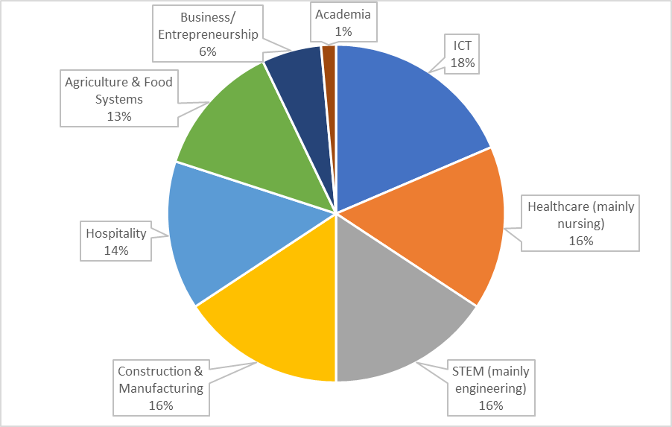
SECTORS TARGETED IN SMSs
Notes:
Link with development plans → broader agendas (trade)
Use the diaspora as a resource (for integration, for investment, for development)
Clear frameworks, policies, procedures
Costing model\burden sharing
How to measure success
Need to tie SMPs to broader agendas
Solution: work more with diasporas (as a resource) → for integration, trade, development links
SMPs need clear frameworks, procedures (think about timing of different things that need to happen – eg. visa allocation)
Costing model not well developed
How to measure success?
Data on the wider impact of these programmes on the labour market
SMPs are often conducted at a relatively small scale
who and what do we mean when we say working with the private sector
issue is co-creation
Capacity
Actors
Ability to reform\adapt systems
Regional qualification systems
Data:
Identifying needs, shortages
End-user (job-matching)
Lessons for future Global Skills Partnership design
Countries must commit politically to the skills mobility partnerships to ensure that the objectives of these are met
The measures to expand skilled labour supply must build skills at the origin in an effective manner
The receiving country has to ensure mechanisms for skill/experience recognition
The programme should foster employer linkages with graduates from the programme
There should be interministerial coordination where the governments from each country involved plan jointly for the partnership
In the APTC campuses, Australian expatriate staff were used which was very costly. Instead, the programme could have used local training facilities which would have been cheaper and more beneficial for Pacific Island States

Slide 17
SKILL LEVELS TARGETED IN SMSs
Notes:
Link with development plans → broader agendas (trade)
Use the diaspora as a resource (for integration, for investment, for development)
Clear frameworks, policies, procedures
Costing model\burden sharing
How to measure success
Need to tie SMPs to broader agendas
Solution: work more with diasporas (as a resource) → for integration, trade, development links
SMPs need clear frameworks, procedures (think about timing of different things that need to happen – eg. visa allocation)
Costing model not well developed
How to measure success?
Data on the wider impact of these programmes on the labour market
SMPs are often conducted at a relatively small scale
who and what do we mean when we say working with the private sector
issue is co-creation
Capacity
Actors
Ability to reform\adapt systems
Regional qualification systems
Data:
Identifying needs, shortages
End-user (job-matching)
Lessons for future Global Skills Partnership design
Countries must commit politically to the skills mobility partnerships to ensure that the objectives of these are met
The measures to expand skilled labour supply must build skills at the origin in an effective manner
The receiving country has to ensure mechanisms for skill/experience recognition
The programme should foster employer linkages with graduates from the programme
There should be interministerial coordination where the governments from each country involved plan jointly for the partnership
In the APTC campuses, Australian expatriate staff were used which was very costly. Instead, the programme could have used local training facilities which would have been cheaper and more beneficial for Pacific Island States

Slide 18
WHERE ARE THE GAPS? WHAT ARE THE CHALLENGES?
Major challenges reported
Conducting research for labour market demand and skills mismatch
Collaborating between public and private sector stakeholders
Building trust between co-operating partners
Forming stakeholder partnerships
Matching candidates with employers
Political commitment
Gaps
Truly co-created initiatives from conception forward
Questions on sustainability and scalability
Strength of business case\mutual benefits
Definition of skills developed
Lack of monitoring and evaluation
Link with development in country of origin
Clear measure of success
Notes:
Link with development plans → broader agendas (trade)
Use the diaspora as a resource (for integration, for investment, for development)
Clear frameworks, policies, procedures
Costing model\burden sharing
How to measure success
Need to tie SMPs to broader agendas
Solution: work more with diasporas (as a resource) → for integration, trade, development links
SMPs need clear frameworks, procedures (think about timing of different things that need to happen – eg. visa allocation)
Costing model not well developed
How to measure success?
Data on the wider impact of these programmes on the labour market
SMPs are often conducted at a relatively small scale
who and what do we mean when we say working with the private sector
issue is co-creation
Capacity
Actors
Ability to reform\adapt systems
Regional qualification systems
Data:
Identifying needs, shortages
End-user (job-matching)
Lessons for future Global Skills Partnership design
Countries must commit politically to the skills mobility partnerships to ensure that the objectives of these are met
The measures to expand skilled labour supply must build skills at the origin in an effective manner
The receiving country has to ensure mechanisms for skill/experience recognition
The programme should foster employer linkages with graduates from the programme
There should be interministerial coordination where the governments from each country involved plan jointly for the partnership
In the APTC campuses, Australian expatriate staff were used which was very costly. Instead, the programme could have used local training facilities which would have been cheaper and more beneficial for Pacific Island States

Slide 19
What about development in the country of origin?

Slide 20
How does migration contribute to development in countries of origin?
Emigration acts as a safety valve for the labour market
Remittances represent a source of finance for development
Diasporas are an enabler for social development
Brain circulation helps strengthen human capital & innovation
Invest in the development of skills in origin countries to foster the acumulation of human capital
Help reduce remittance costs and invest in financial training
Fund diaspora projects in countries of origin
Develop return programmes oriented towards productive investment
Notes:
Policies areas:
On the cost
On capacity development at sending (including material)
On matching
Either at transfer
Either in destination area (bonds, microprogrammes)
Capacity development at receiving (financial training, entrepreneurship, bancarisation)
Monitoring
How much are they paying?
How are they transferring?

Slide 21
Integrating components of migration and development into SMSs
Labour market assessments:
73%
Remittances & financial inclusion:
9%
Diaspora stakeholders:
9%
Return & reintegration:
54%

Slide 22
Capacity Building
(36%)
Capacity Building
Education
Data Management
Institutions: dialogue and exchanges

Slide 23
Training in CoO
(14%)
Home Track
Address skills needs of CoO
Away Track
Address skills needs of CoD
Cultural and language training
Dual Track

Slide 24
National development strategies
(9%)
Development Strategies\national priorities
Sectoral Plans
Skills mobility schemes
Notes:
National Development Strategies & National Sectoral Strategies
THAMM
National strategies, e.g. (National Immigration and Asylum Strategy) SNIA in Morocco
PALIM
Morocco's national strategy for inclusive digitalization
PEM WECCO
Addresses Senegal's 6 priority sectors: agriculture, food systems, aquaculture, digital, healthcare and tourism
Accessing Overseas Employment Opportunities for Moroccan Youth Project
Morocco’s Strategic Action Plan of the Ministry of Employment (2014-16 ) and their National Strategy for Employment (2015–25)

Slide 25
Biggest gap:
Integrating SMSs into the broader picture
Green Transition
Future of work
National development plans
New technologies

